Slide 1

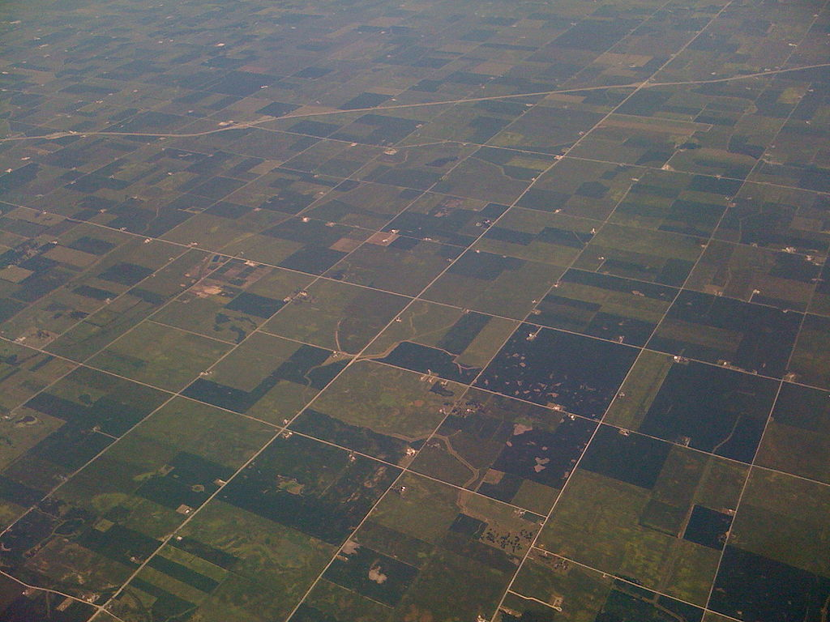

(Ezekiel 47:14)
Fair Division of Land
Erel Segal-haLevi
Advisors:
Yonatan Aumann Avinatan Hassidim Shmuel Nitzan
Notes:
1
1
1
1
1
1
1
1
1

Slide 2
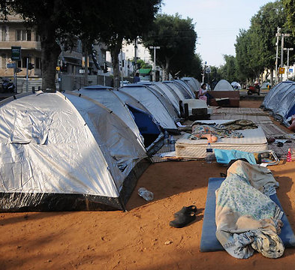
Fair division of Land
Divide:
- Public lands to homeless.
- Family estate to heirs.
- Museum space to presenters.
- Webpage space to ads.
Land is heterogeneous.
Different people prefer different parts of the land.
We want everyone to agree that the division is fair.
L

Slide 3
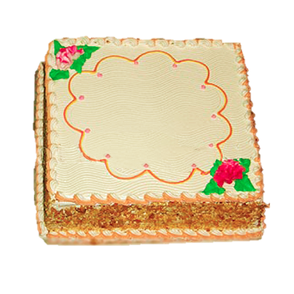
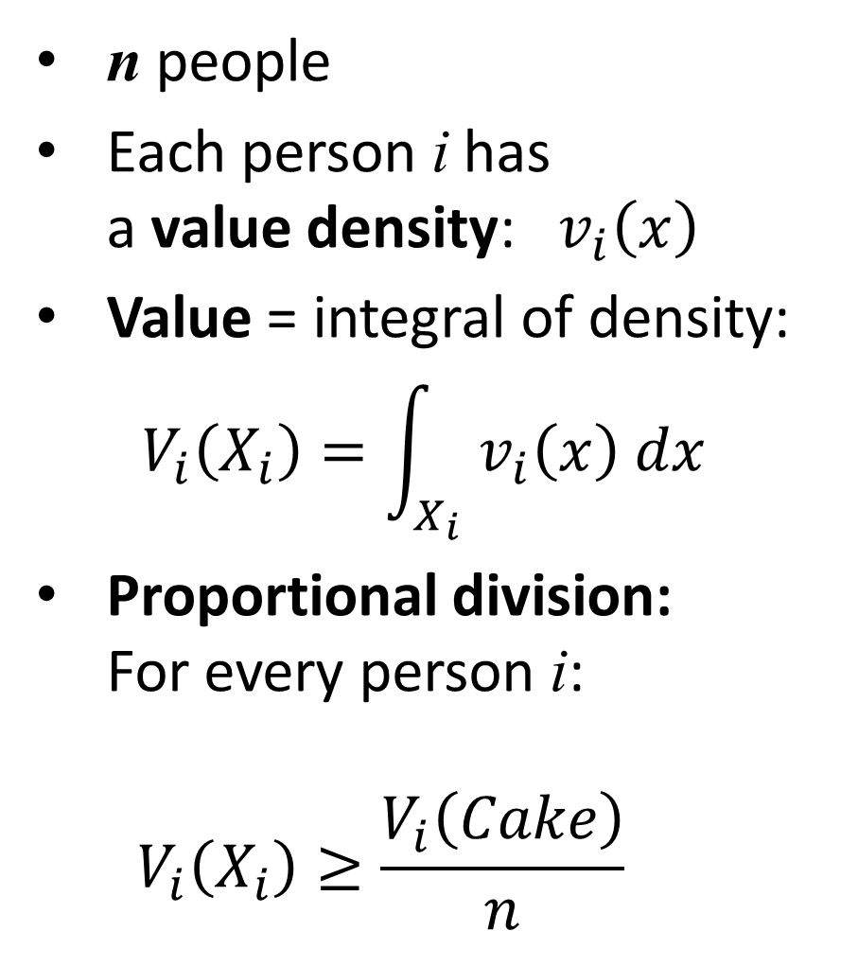
Fair Division of a Cake
Fair division of Land: applications
n people
Each person i has a value density: $v_{i}\left(x\right)$
Value = integral of density:
$${ V}_{i}\left(X_{i}\right)=\int_{X_{i}}{v_{i}\left(x\right) dx}$$
Proportional division: For every person i: $V_{i}\left(X_{i}\right)≥\frac{V_{i}\left(Cake\right)}{n}$

Slide 4
Fair Division of a Cake: two people
Each person marks a north-south line dividing land to two parts with subjective value 1/2.
Land is cut between the two division lines.
Each person receives part with his/her line.
G
B
For every person playing by the rules: $V_{i}\left(X_{i}\right)≥1/2$

Slide 5
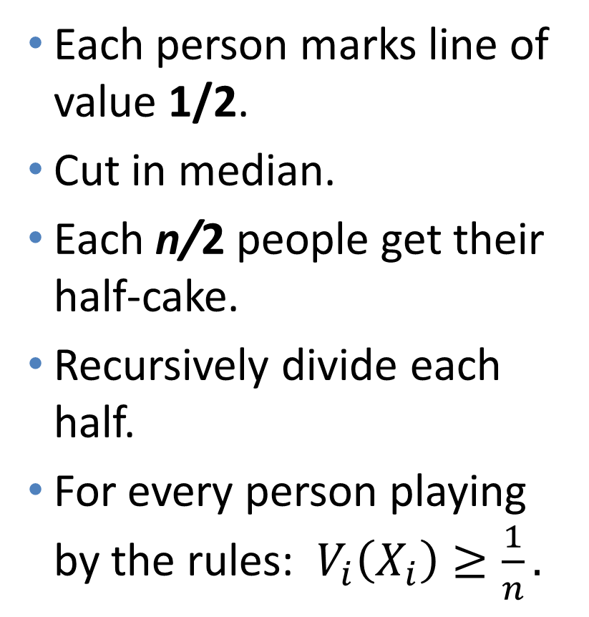
Fair Division of a Cake: n people
(Even and Paz, 1984)
Each person marks line of value 1/2.
Cut in median.
Each n/2 people get their half-cake.
Recursively divide each half.
For every person playing by the rules: $V_{i}\left(X_{i}\right)≥\frac{1}{n}.$
G
B
P
R

Slide 6
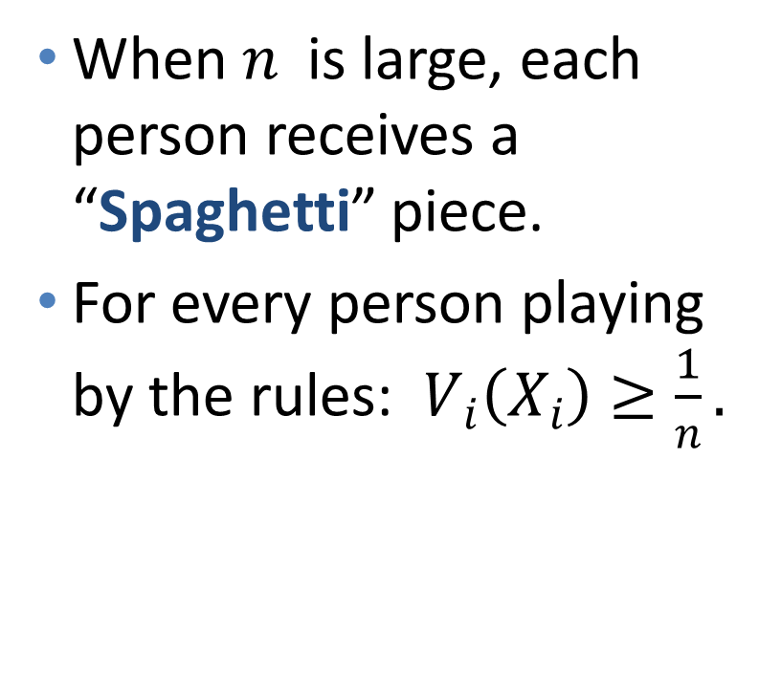
Fair Division of a Cake: n people
(Even and Paz, 1984)
When $n$ is large, each person receives a “Spaghetti” piece.
For every person playing by the rules: $V_{i}\left(X_{i}\right)≥\frac{1}{n}.$

Slide 7
But Cake ≠ Land !
1. Geometry: No / 1-dim. Yes, 2-dim.
2. Redivision: No Yes
3. Ownership: Individual Family

Slide 8

From Cakes to Lands
→
1. Geometry: No / 1-dim. Yes, 2-dim.
2. Redivision: No Yes
3. Ownership: Individual Family
"Fair and Square - Cake-Cutting in Two Dimensions“. Under revision for Journal of Mathematical Economics.
"Envy-Free Cake-Cutting in Two Dimensions“. Appeared in the Proceedings of the AAAI, 2015.

Slide 9
1. Geometry: example
Can we give each person at least 1/2?
In a rectangle: yes
In a square?
No! Only at most 1/4.
In an R-fat rectangle? (length/width ≤ R)
2 people: blue and green

Slide 10
1. Geometry: impossibility
Can we give each agent at least 1/2?
In a rectangle: yes
In a square?
No! Only at most 1/4.
In an R-fat rectangle? (length/width ≤ R)
No! Only at most 1/3.
2 agents: blue and green

Slide 11
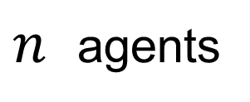
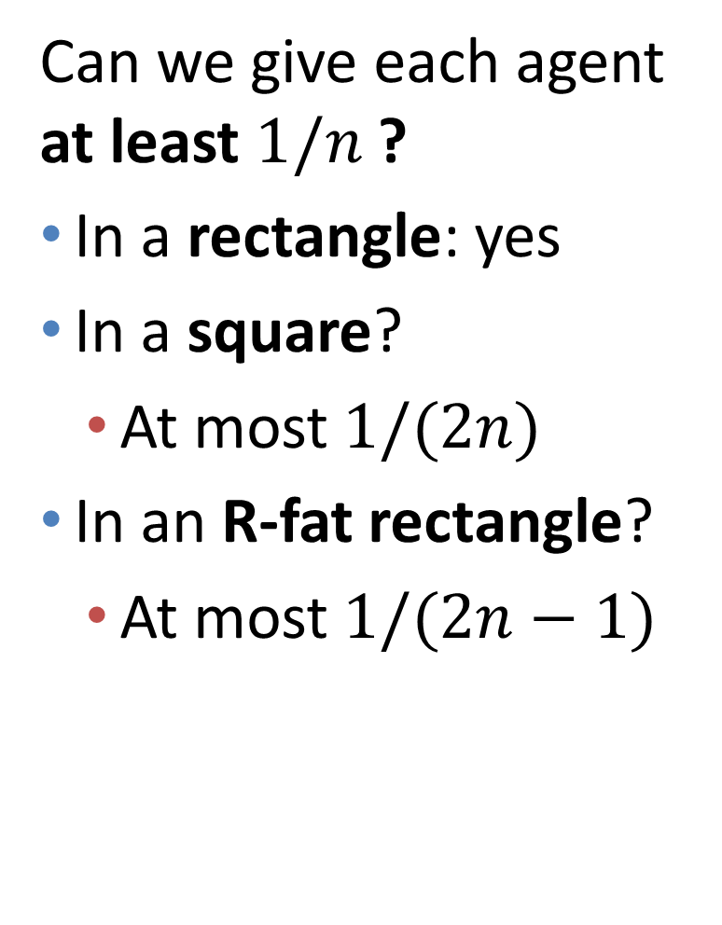
1. Geometry: impossibility
Can we give each agent at least $1/n$ ?
In a rectangle: yes
In a square?
At most $1/(2n)$
In an R-fat rectangle?
At most $1/(2n−1)$
$n$ agents

Slide 12
1. Geometry
Can we give each agent at least 1/2?
In a rectangle: yes
In a square?
No! Only at most 1/4.
Can we always give both agents 1/4 in a square?
Yes!
2 agents: blue and green

Slide 13
1. Geometry: division procedure
Divide to 4 quarters.
Each agent chooses favorite quarter.
Easy case: different choices.
Allocate choices and finish.
B
G

Slide 14
1. Geometry: division procedure
Divide to 4 quarters.
Each agent chooses favorite quarter.
Hard case: same choice.
Each agent marks corner-square inside choice, with value exactly 1/4.
G
B

Slide 15
1. Geometry: division procedure
Each agent marks corner-square inside choice, with value exactly 1/4.
Cut between lines.

Slide 16
1. Geometry: division procedure
Each agent marks corner-square inside choice, with value exactly 1/4.
Cut between lines.
Each person receives piece with his line.
CoverNum(B, Squares)=3
Bar-Yehuda & Ben-Hanoch, “A linear-time procedure for covering simple polygons with similar rectangles“, Int. J. of Computational Geometry & Applications, 1996
B
Val ≥ 3/4
G
Val ≥ 1/4

Slide 17
1. Geometry: division procedure
Each agent marks corner-square inside choice, with value exactly 1/4.
Cut between lines.
Each person receives piece with his line.
CoverNum(B, Squares)=3
SquareValue ≥ TotalValue / CoverNum
B
Val ≥ 1/4
G
Val ≥ 1/4

Slide 18
1. Geometry: Walls and Open Bounds
2 ppl
n ppl
1/4
1/3
1/3
1/2
1/2
≤1/ 2n
1/ (2n-1)
≤1/1.75n
≤1/ n
≥1/ (4n-4)
≥1/ (2n-1)

Slide 19
1. Geometry: quarter-plane
In a quarter-plane, we want to give each agent a square with value ≥ 1/(2n-1)

Slide 20
1. Geometry: k-staircase
In a k-staircase,
we can give each agent a square with value ≥ 1/(2n+k-2)
k=4

Slide 21
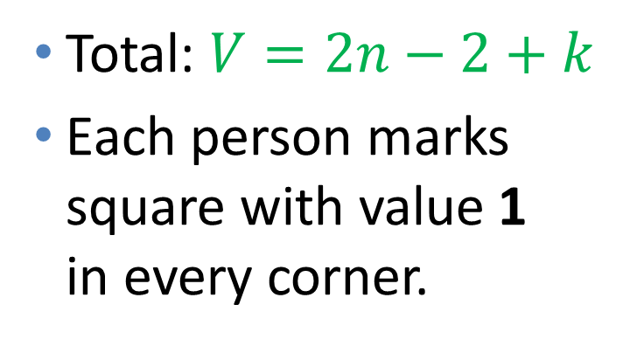
1. Geometry: k-staircase
Total: $V=2n−2+k$
Each person marks square with value 1 in every corner.

Slide 22
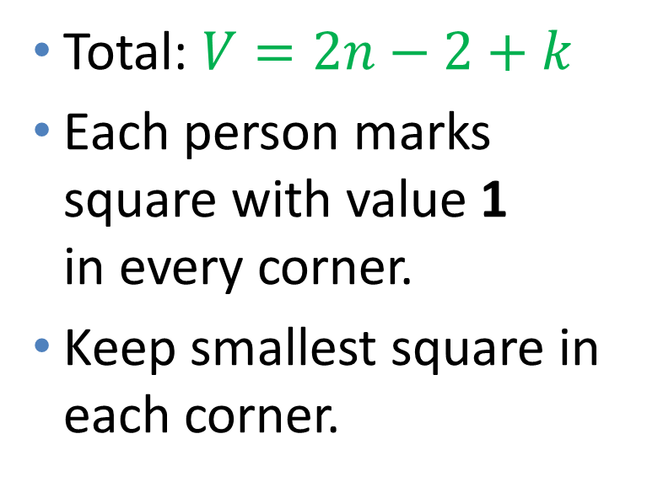
1. Geometry: k-staircase
Total: $V=2n−2+k$
Each person marks square with value 1 in every corner.
Keep smallest square in each corner.

Slide 23
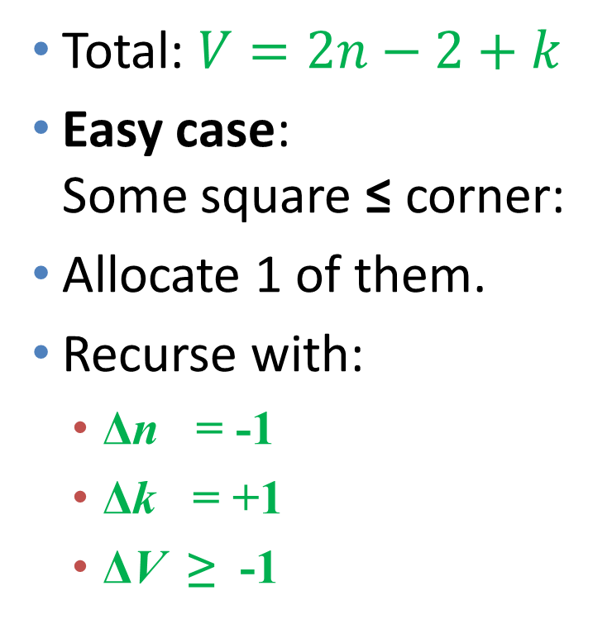
1. Geometry: k-staircase
Total: $V=2n−2+k$
Easy case: Some square ≤ corner:
Allocate 1 of them.
Recurse with:
Δn = -1
Δk = +1
ΔV ≥ -1

Slide 24
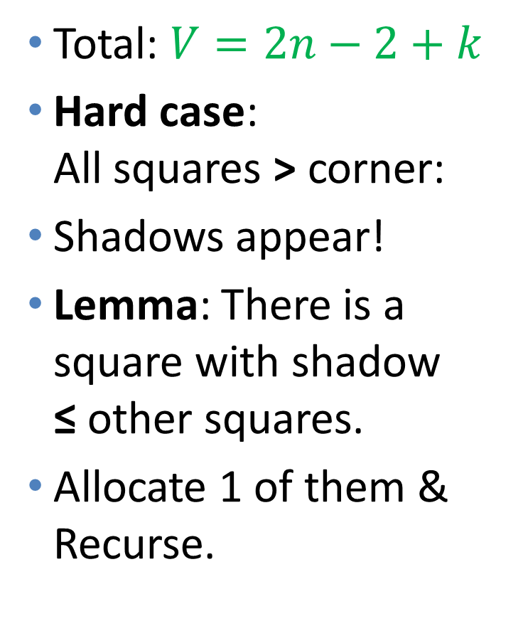
1. Geometry: k-staircase
Total: $V=2n−2+k$
Hard case: All squares > corner:
Shadows appear!
Lemma: There is a square with shadow ≤ other squares.
Allocate 1 of them & Recurse.

Slide 25
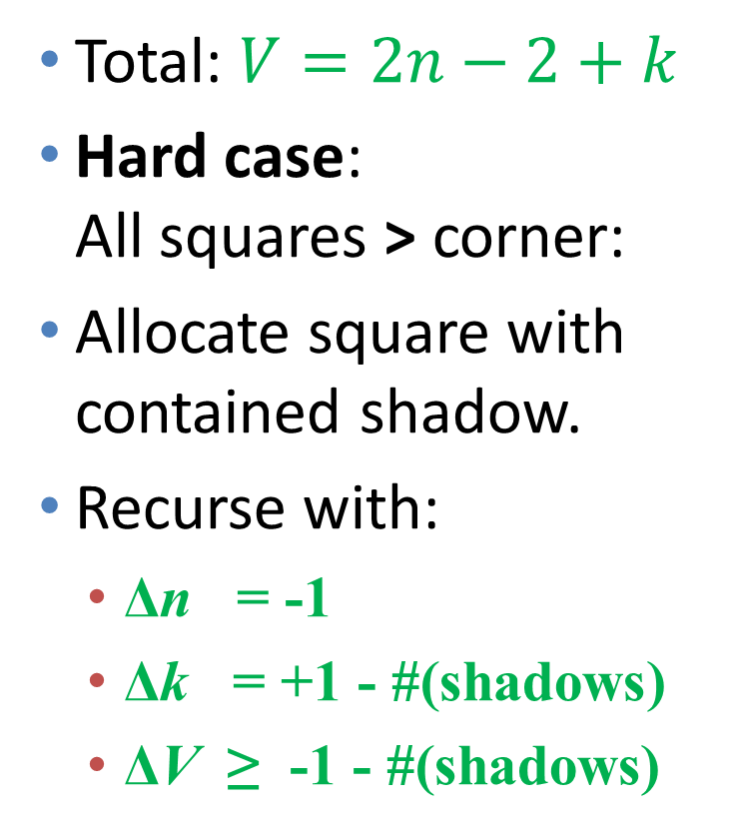
1. Geometry: k-staircase
Total: $V=2n−2+k$
Hard case: All squares > corner:
Allocate square with contained shadow.
Recurse with:
Δn = -1
Δk = +1 - #(shadows)
ΔV ≥ -1 - #(shadows)

Slide 26
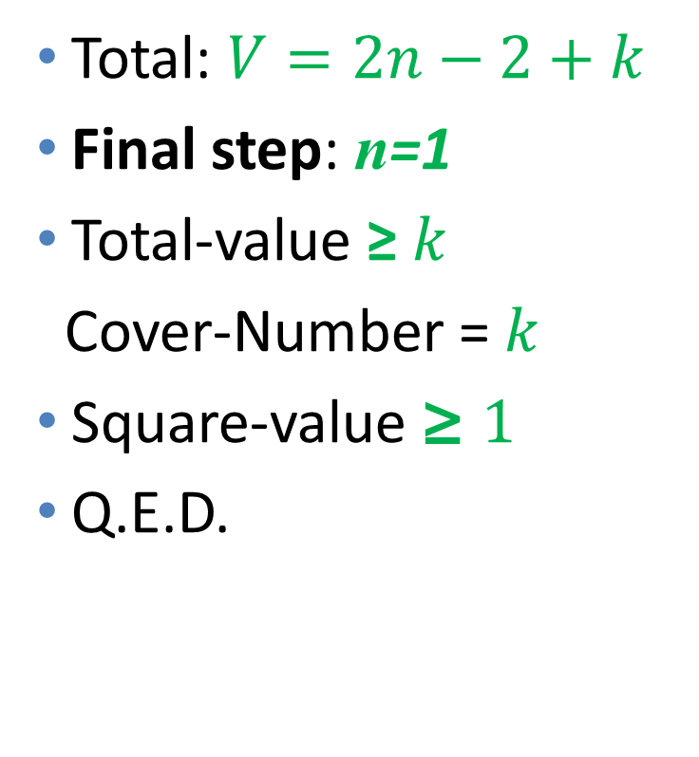
1. Geometry: k-staircase
Total: $V=2n−2+k$
Final step: n=1
Total-value ≥ $k$
Cover-Number = $k$
Square-value ≥ $1$
Q.E.D.

Slide 27
1. Geometry: Walls and Open Bounds
2 ppl
n ppl
1/4
1/3
1/3
1/2
1/2
≤1/ 2n
1/ (2n-1)
≤1/1.75n
≤1/ n
≥1/ (4n-4)
≥1/ (2n-1)

Slide 28
1. Geometry
Cake: square
Pieces: squares
Value guarantee: 1/(4n-4)
Upper bound: 1/(2n)

Slide 29
1. Geometry
Cake: square with 3 walls
Pieces: squares
Value guarantee: 1/(2n-1)
Upper bound: 1/(2n-1)

Slide 30
1. Geometry
Cake: square with 2 walls
Pieces: squares
Value guarantee: 1/(2n-1)
Upper bound: 1/(2n-1)

Slide 31
1. Geometry
Cake: square with 1 wall
Pieces: squares
Value guarantee: 1/(2n-2)
Upper bound: 1/(1.75n-1)

Slide 32
1. Geometry
Cake: square with no walls
Pieces: squares
Value guarantee: 1/(2n-4)
Upper bound: 1/n

Slide 33
1. Geometry
Cake: square
Pieces: R-fat rectangles
Value guarantee: 1/(4n-5)
Upper bound: 1/(2n-1)

Slide 34
1. Geometry
Cake: square
Pieces: 2-fat polygons
Value guarantee: 1/(2n-2)
Upper bound: 1/n

Slide 35
1. Geometry
Cake: rectilinear, T outer corners
Pieces: rectangles
Value guarantee: 1/(n+T)
Upper bound: 1/(n+T)
1
5
6
2
4
3

Slide 36
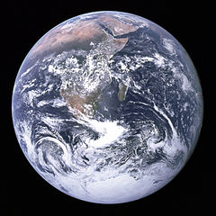
1. Geometry
Cake: sphere
Pieces: spherical squares
Value guarantee: ?
Can we divide
Earth
Fair-and-Square?

Slide 37
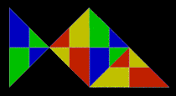
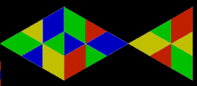
1. Geometry
Cake: fish
Pieces: fish
Value guarantee: 1/(16n-23)
Upper bound: 1/n

Slide 38
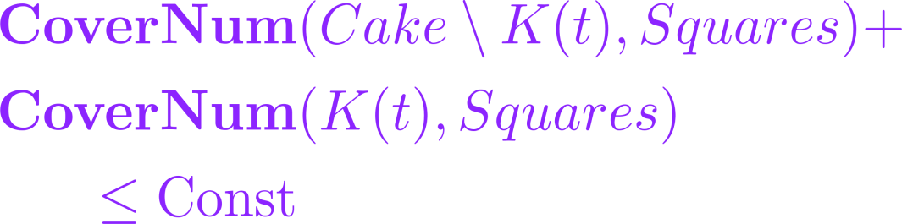
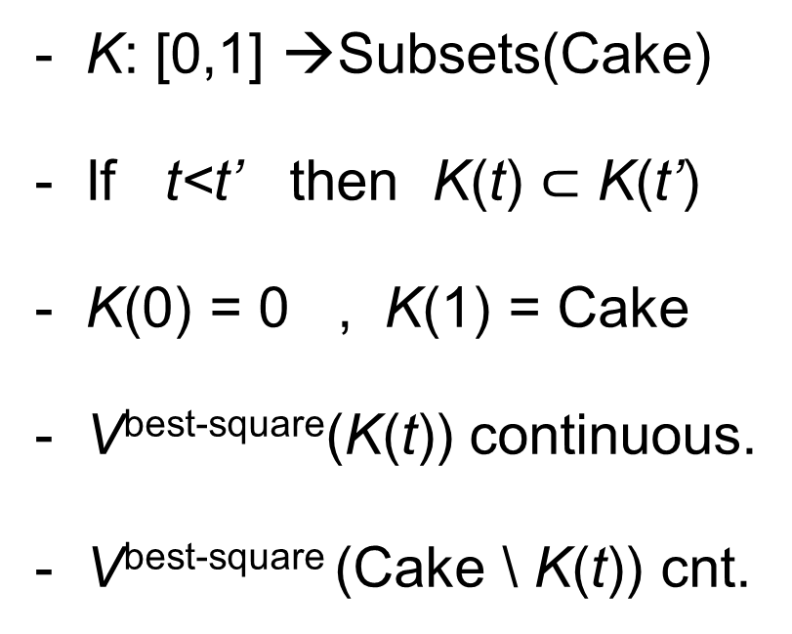
1. Geometry: example procedure
1. Geometry: the super-knife
- K: [0,1] →Subsets(Cake)
- If t<t’ then K(t) $⊂$ K(t’)
- K(0) = 0 , K(1) = Cake
- V^{best-square}(K(t)) continuous.
- V^{best-square} (Cake \ K(t)) cnt.
Stopper
Other
Division is envy-free;
Value-per-agent at least 1/4.

Slide 39
1. Geometry
For n agents:
we need a “kitchen” (set of knives)
Pieces: fat rectangles
Pieces: square-pairs
Pieces: fat convex polygons

Slide 40
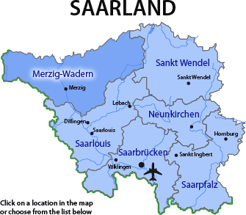
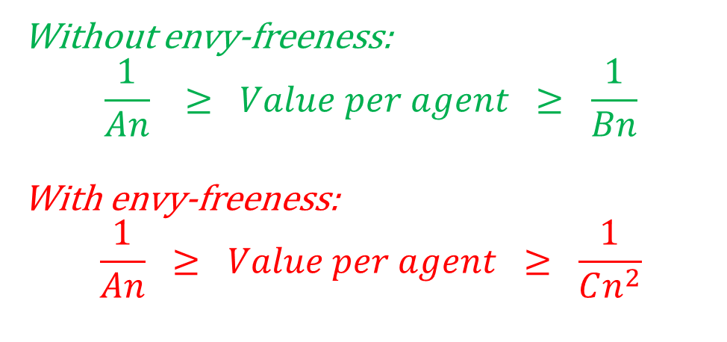
1. Geometry: non-square cakes
Cake: fat
Pieces: fat
Cake: infinite plane
Pieces: squares
Cake: rect. polygon
Pieces: rectangles
Without envy-freeness:
$$\frac{1}{An} ≥ Value per agent ≥ \frac{1}{Bn}$$
With envy-freeness:
$$\frac{1}{An} ≥ Value per agent ≥ \frac{1}{Cn^{2}}$$

Slide 41

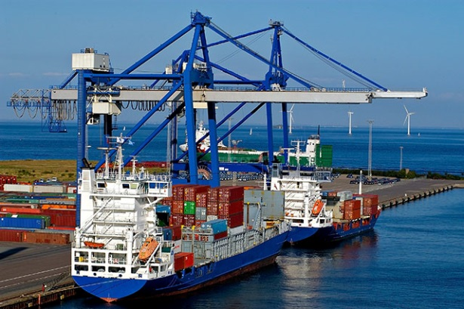
2. Redivision – more land
Joint work with Balázs Sziklai from the Hungarian Academy of Sciences
“Can anyone benefit from growth?”
(Moulin and Thomson, 1988)
Cake
Ext

Slide 42
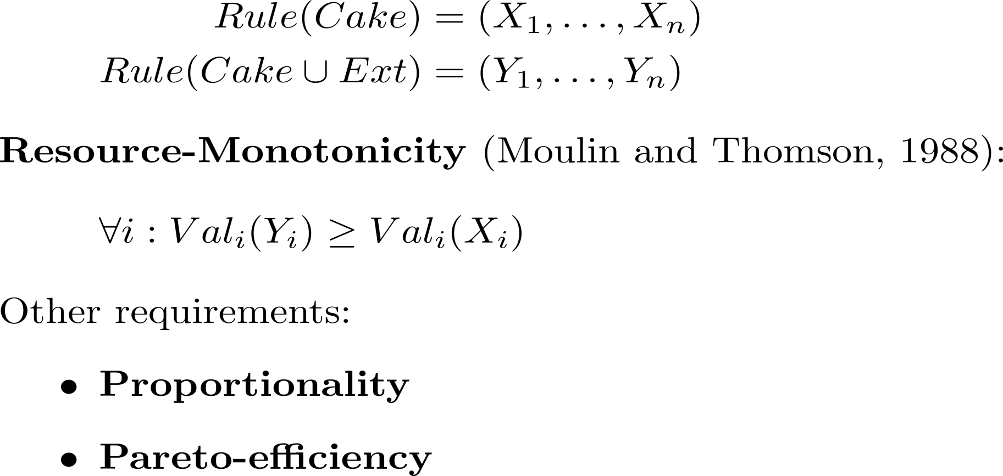
2. Redivision – more land
Cake
Ext

Slide 43
2. Redivision – more land
Cake
Ext
Cut-and-choose:
Blue cuts, Green chooses.
Value of Green in Cake: 2
Value of Green in Cake+Ext: 1
➔ not monotonic.

Slide 44
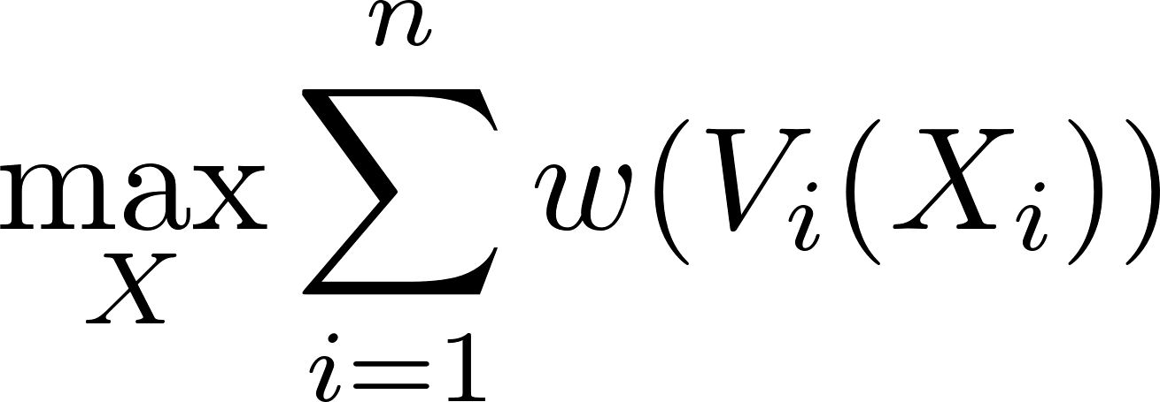
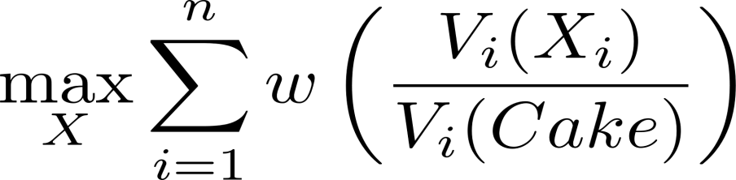
2. Redivision – more land
1. Exact division: Proportional, monotonic, but not Pareto.
2. Absolute-w-maximizer (w increasing and concave): Pareto, monotonic, but usually not proportional.
3. Relative-w-maximizer (w increasing and hyper-concave): Pareto, proportional, but usually not monotonic.

Slide 45
2. Redivision – more land
What rule is simultaneously absolute-w-maximizer and relative-w-maximizer, with same w?
--- The Nash-optimal rule! w = log.
Pareto, proportional, and monotonic.
Adds support to “The unreasonable fairness of maximum Nash welfare” (Caragiannis, Kurokawa, Moulin, Procaccia, Shah, Wang; ‘16)
- But, does not work with connected pieces.
- Impossible to get Pareto + prop. + monotonicity.

Slide 46
From Cakes to Lands
1. Geometry: No / 1-dim. Yes, 2-dim.
2. Redivision: No Yes
3. Ownership: Individual Family

Slide 47
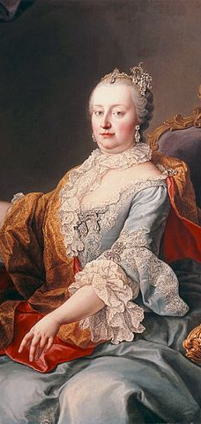
2. Redivision – Land Reform
Ancient Egypt, Greece, Rome
Feudal Europe (18th-19th century)
South America, Asia, Africa, Scotland (20th-21th century)
… and most other countries too.
Can it be done better?
Maria Theresa
(1717-1780)

Slide 48
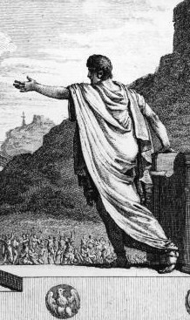
2. Redivision – Land Reform
Ancient Egypt, Greece, Rome
Gaius Gracchus
(154–121 BC)

Slide 49
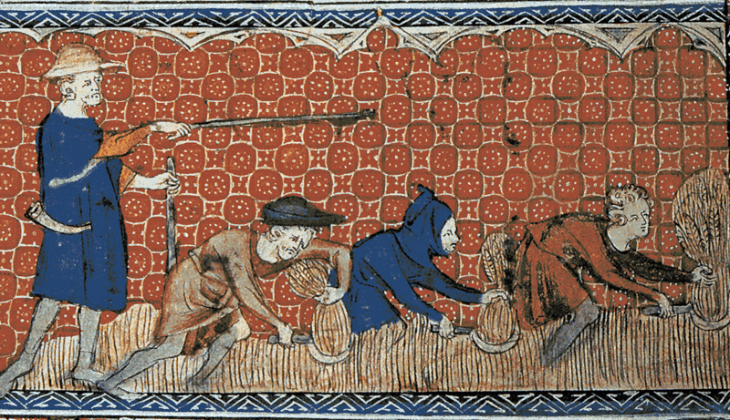
2. Redivision – Land Reform
Ancient Egypt, Greece, Rome
Feudal Europe (18th-19th century)
Maria Theresa
(1717-1780)

Slide 50
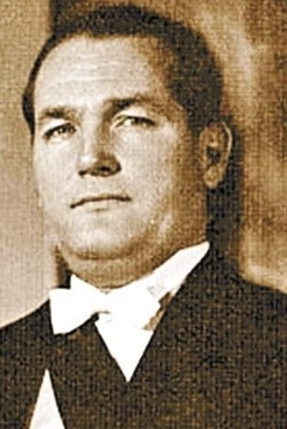
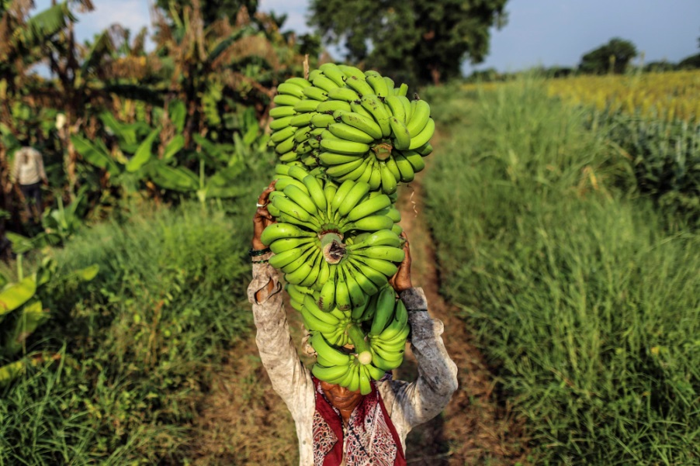
2. Redivision – Land Reform
Ancient Egypt, Greece, Rome
Feudal Europe (18th-19th century)
America, Asia, Africa, Scotland (20th-21th century)
Juan José Arévalo, Guatemala
(1904-1990)

Slide 51
2. Redivision – Land Reform
Ancient Egypt, Greece, Rome
Feudal Europe (18th-19th century)
America, Asia, Africa, Scotland (20th-21th century)
… and most other countries too.
Can it be done better?

Slide 52
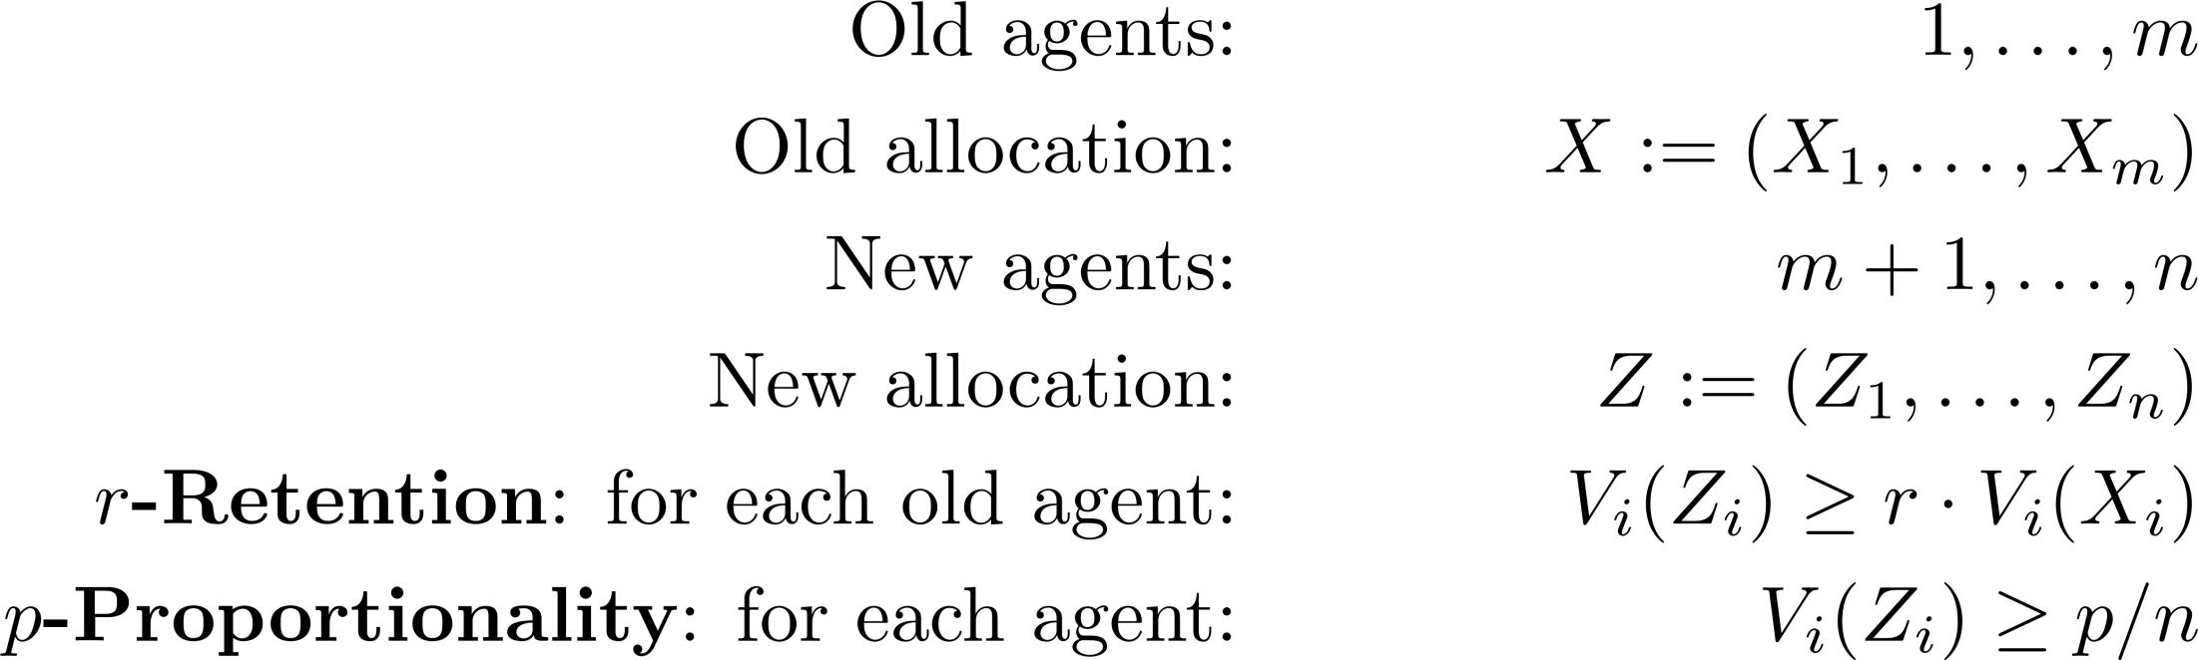
2. Redivision – model
What pairs (r,p) are attainable?

Slide 53
2. Redivision – existence
Theorem 1. For all r in [0,1], there exists a division with r-retention and (1-r)-proportionality.
Proof.
The set of utilities of divisions is convex (Dubins and Spanier, 1961).
Given divisions X,Y, there exists division Z such that:
Take X as the original division and Y as any proportional division.

Slide 54
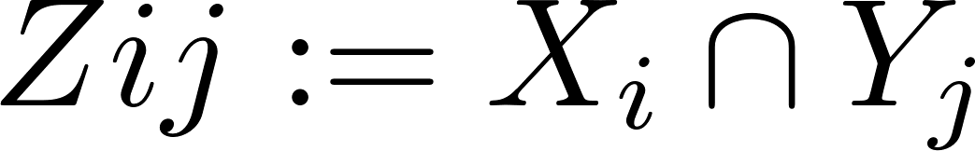
2. Redivision – procedure
Theorem 1.5. Given integers P<Q and r=P/Q in [0,1], there is a procedure that finds a division with at least r-retention and at least (1-r)-proportionality.
Procedure. Find proportional division Y. For every pair of agents i, j, define:
Agent j cuts Zij to Q subjectively equal pieces.
Agent i picks P best pieces (relative value at least r).
Agent j takes remaining Q-P pieces (relative value 1-r).
Interpretation: a procedure for land-reform.

Slide 55
2. Redivision+Geometry
The cake is, and each piece X_{i} must be:
Interval (1-dim.),
Rectangle (2-dim.),
The set of utilities of divisions is not convex.
A proportional division always exists.
What retention can be guaranteed?

Slide 56
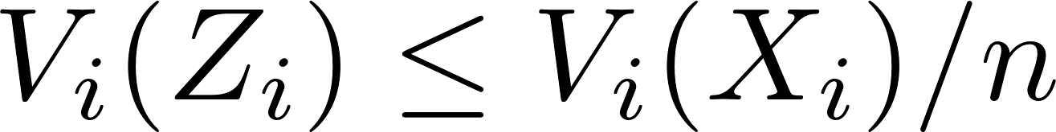
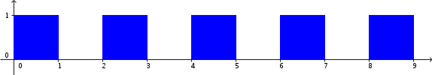
2. Redivision+Geometry - impossibility
Theorem 2 - intervals. For every division X, for every positive p, it is possible that in every p-proportional division Z, for some old agent i:
Proof. Consider an agent i with value density like:
And assume each other agent has value only in one ‘hole’.

Slide 57
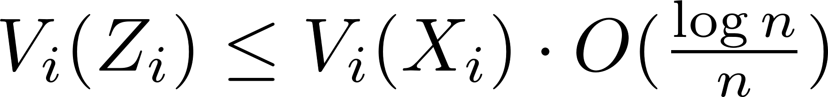
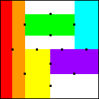
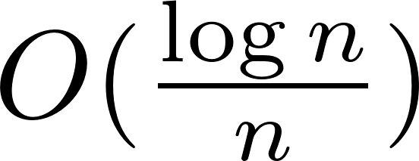
Geometric constraints - impossibility
Theorem 2 - rectangles. For every division X, it is possible that in every positive division Z, for some i:
Proof. Consider an agent i with value uniform in X_{i,} and assume each other agent has value only in one ‘hole’, where the holes are arranged like this:
Then, the largest rectangle that does not cover any “hole” has an area of: of the total area of X_{i}.

Slide 58
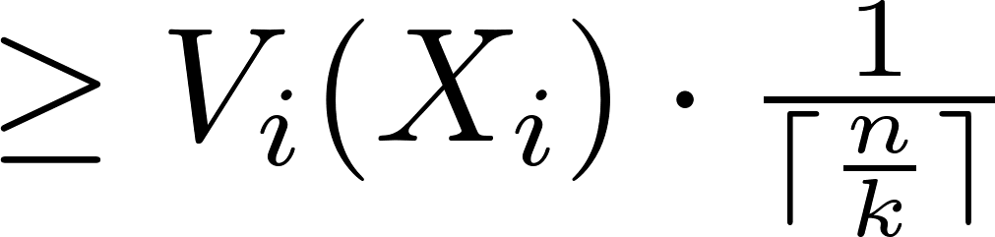
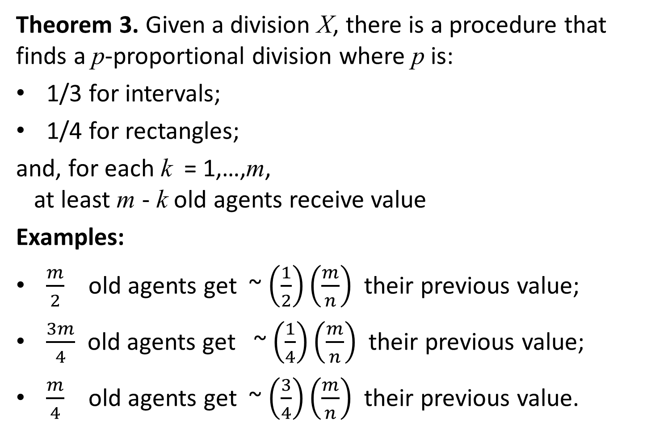
2. Redivision+Geometry - possibility
Theorem 3. Given a division X, there is a procedure that finds a p-proportional division where p is:
1/3 for intervals;
1/4 for rectangles;
and, for each k = 1,…,m, at least m - k old agents receive value
Examples:
$\frac{m}{2}$ old agents get ~ $\left(\frac{1}{2}\right)\left(\frac{m}{n}\right)$ their previous value;
$\frac{3m}{4}$ old agents get ~ $\left(\frac{1}{4}\right)\left(\frac{m}{n}\right)$their previous value;
$\frac{m}{4}$ old agents get ~ $\left(\frac{3}{4}\right)\left(\frac{m}{n}\right)$ their previous value.

Slide 59

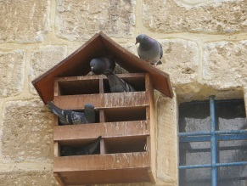
2. Redivision+Geometry - possibility
Procedure idea:
Treat each old piece X_{i} as an island.
Divide the archipelago giving each agent a piece in one island.
By the pigeonhole principle, most islands will not be crowded.
Hence, most agents will recover a significant piece of their previous plot.
Interpretation: a procedure for land-reform.
X₁
X₂
X₃
X_{n}

Slide 60
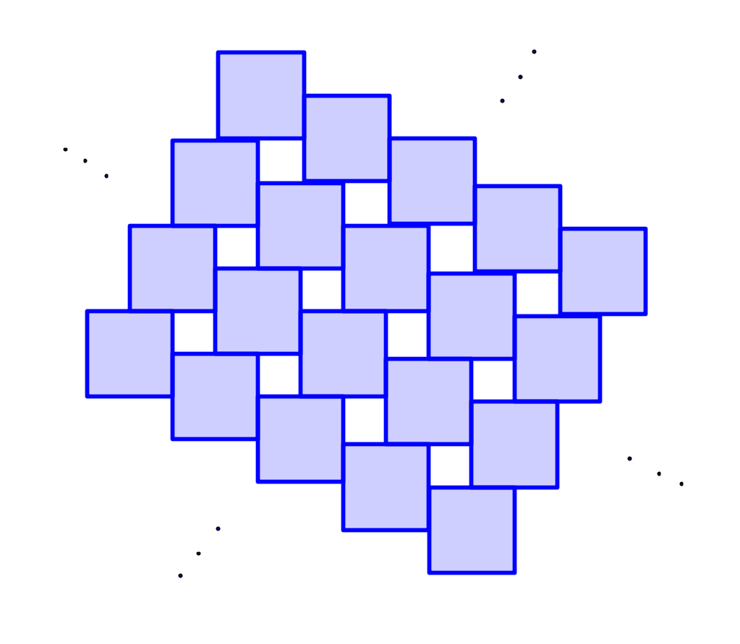
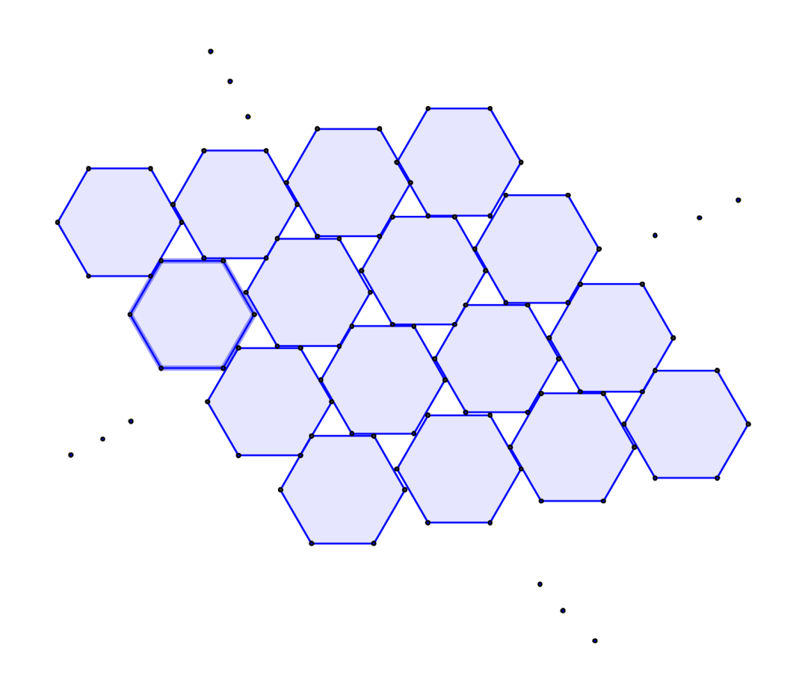
1. Allocation Completion
X₁
X₂
Intervals: There is always a utilitarian division where all cake is divided. n pieces. Rectangles/Convex pieces: it is possible that in the utilitarian division, not all cake is divided! In this case, the division should be completed.
Rectangles: A complete partition with 2n pieces exists.
Convex: A complete partition with 3n pieces exists.
X_{n}
X₁
X₂
X_{n}

Slide 61
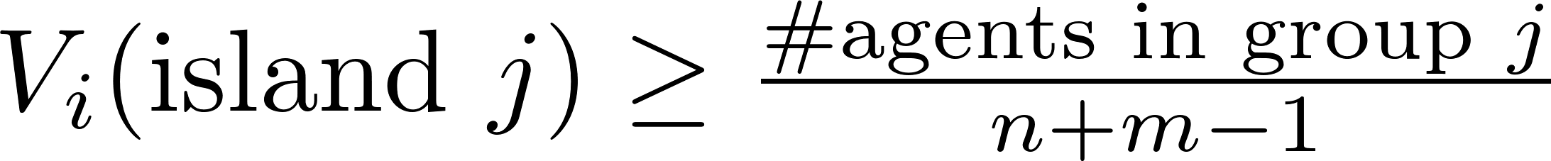
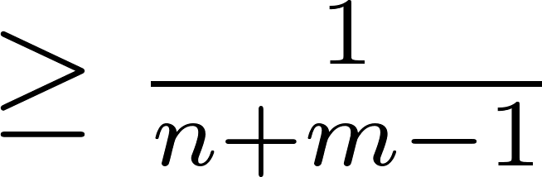
2. Redivision+Geometry - procedure
INPUT: n agents, m islands (here: m ≤ n).
OUTPUT: A partition of the agents to m groups, such that for each agent i in group j:
USAGE: Divide the archipelago giving each agent a piece in a single island, with value
X₁
X₂
X₃
X_{n}

Slide 62
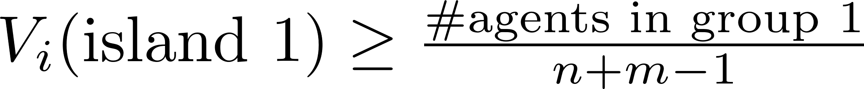
2. Redivision+Geometry - procedure
PROCEDURE:
Ask each agent to evaluate island #1.
Order agents by decreasing value.
Send agents to island #1 until value of next agent is too small relative to number of inhabitants.
for each agent i in group 1:
Do the same with remaining agents and islands.
X₁
X₂
X₃
X_{n}

Slide 63
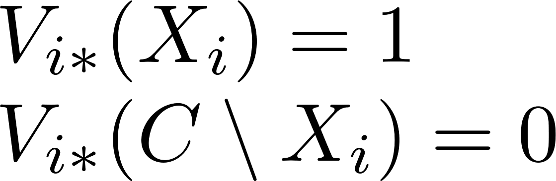
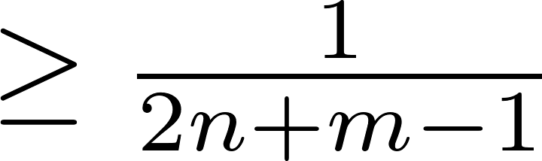
2. Redivision+Geometry - procedure
a. For each agent i, create a “helper” i*, that wants only the plot of agent i in division X:
b. Use archipelago division procedure with: n agents + n helpers. Value:
c. Let each agent select between own piece and helper’s piece.

Slide 64
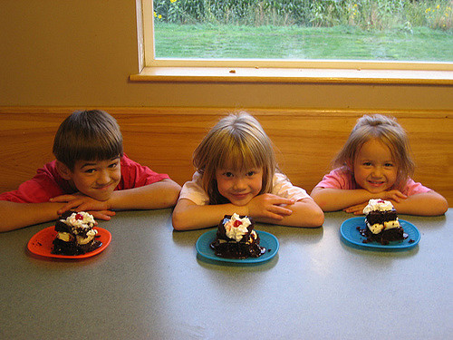
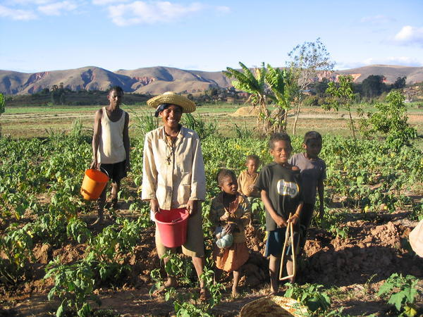
From Cakes to Lands
1. Geometry: No / 1-dim. Yes, 2-dim.
2. Redivision: No Yes
3. Ownership: Individual Family

Slide 65
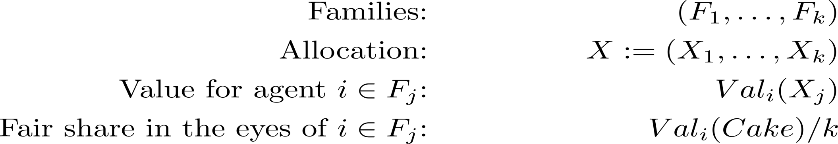
3. Family ownership: Model

Slide 66

3. Family ownership
1. Average proportionality: Easy, but requires inter-personal summation.
2. Unanimous proportionality: No inter-personal sums, but disconnected. 3. Democratic proportionality: No inter-personal sums; connected for k=2.

Slide 67

Cake Cutting → Land Division
1. Geometry 2. Redivision: - More land
- More people
3. Family ownership
4. Land-value data

Slide 68
4. Land-value data
Source: Map of economic (NPV) land-values.
Plus noise to simulate different valuations.
Experiment: compare “objective” division to classic (1-D) cake-cutting procedures according to:
Envy,
Social welfare: egalitarian and utilitarian
Conclusion: Cake-cutting does much better.
Future work: make this experiment in 2-D.

Slide 69
(Ezekiel 47:14)
Lessons I learned so far:
1. Two-dimensional cake-cutting: Geometric concepts have economic implications.
2. Redivision and monotonicity: Nash-optimum is good.
3. Family ownership: Democracy is good.
Thank you!

Slide 70
From Cakes to Lands
1. Geometry: No / 1-dim. Yes, 2-dim.
2. Redivision: No Yes
3. Ownership: Individual Family
* Future work: simulations and experiments with real land-value data
Collaborations are welcome!

Slide 71
(Ezekiel 47:14)
Fair Division of Land
Erel Segal-haLevi
Advisors:
Yonatan Aumann Avinatan Hassidim Shmuel Nitzan
Notes:
71
71
71
71
71
71
71
71
71

Slide 72

1. Geometry: envy-free
General | 1-D
Super knife - K: [0,1] → Borel(Cake) - K(0) = 0 , K(1) = Cake - If t’>t then K(t’) Ↄ K(t) - V^{squares}(K(t)) continuous - V^{squares}(Cake \ K(t)) cont. | Knife
→

Slide 73
1. Geometry: envy-free
Cake: square
Pieces: squares
Agents: 2
Value guarantee: 1/4 + envy-free
Upper bound: 1/4
Stopper
Other

Slide 74
1. Geometry: envy-free
Cake: square
Pieces: squares
Agents: n
Value guarantee: 1/(2n)² + envy-free
Upper bound: 1/(2n)

Slide 75
(Ezekiel 47:14)
Fair Division of Land
Erel Segal-haLevi
Advisors:
Yonatan Aumann Avinatan Hassidim Shmuel Nitzan
Notes:
75
75
75
75
75
75
75
75
75

